Slide 1
EE5703 Project Presentation
Student:A0267468L; Name: Guo Xuanyu;
Student:A0260045R; Name: Miao Chenxin;
Student:A0279710Y; Name: LiuLimin;
Research on Doubly Fed Induction generator (DFIG) in wind turbines
Department of Electrical and Computer Engineering, National University of Singapore,
E-mail: E1099918@nus.edu.sg

Slide 2
CONTENTS
Power control
Vector&stator
current control
PMSG VS DFIG
Results

Slide 3
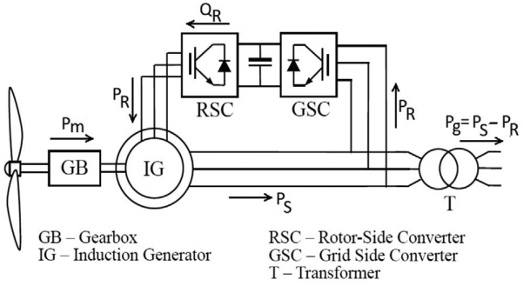
DFIG configuration
DFIG system consists of a rotor, stator and an electronic converter.
As the wind strikes the blades of the turbine, the rotor captures the kinetic energy and converts the wind power into mechanical power. This mechanical power is then transferred to the generator, which further converts it into electrical power.
Notes:
Sample title slide.
Reference:
Katrina Aspmo, Torunn Berg, and Grethe Wibetoe, “Atmospheric Mercury Depletion Events (AMDEs) in Polar Regions During Arctic Spring,” presentation (Oslo, Norway: University of Oslo, 16 June 2004).

Slide 4
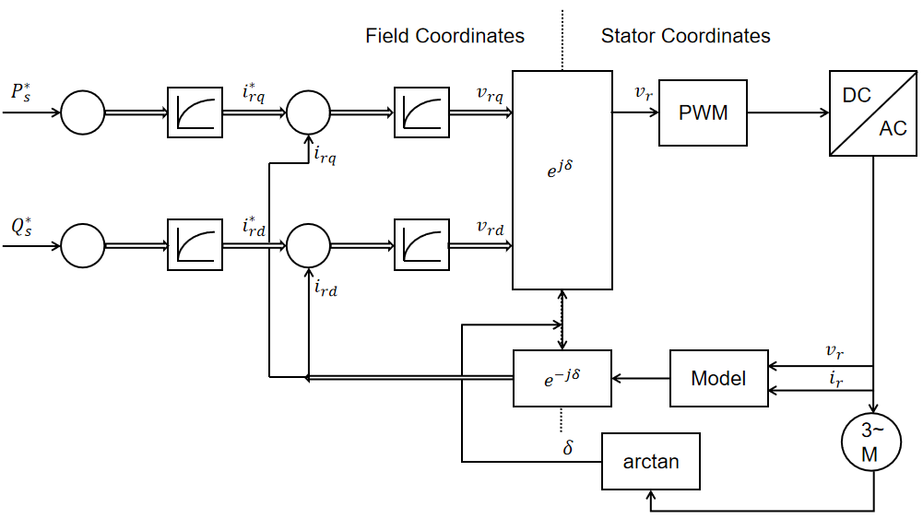
Signal Flow Graph
From the equations above, the signal flow graph of power control is drawn.
The strategy of power control is using the Vector current control method. The basic idea is by calculating the rotor current values based on the desired power output.
Notes:
Blank slide for drafting mapping slide

Slide 5



System modeling
Modeling the system mathematically, using the first principle.
The stator current equation to d-q coordinate obtained as:
The differential equation in stator coordinate decomposed to real part and imaginary part as:
Notes:
Sample mapping slide.
Reference:
Katrina Aspmo, Torunn Berg, and Grethe Wibetoe, “Atmospheric Mercury Depletion Events (AMDEs) in Polar Regions During Arctic Spring,” presentation (Oslo, Norway: University of Oslo, 16 June 2004).

Slide 6
Model Construction
Machine Parameters definition
Reference power calculation
Model Functions
Controller Implementation
Vector control
Control tuning
Notes:
b5008a68-d817-45c4-8638-b7322122ebc3.source.7.zh-Hans

Slide 7
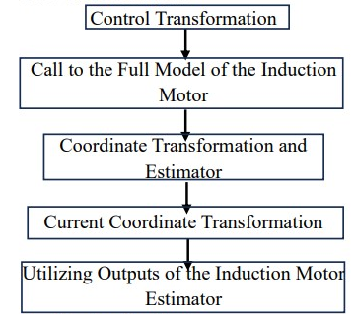
Vector control
Precise Control of Magnetic Field and Currents: Vector control enables independent control of the motor's magnetic field and currents, allowing high-performance operation under various loads and speeds.
By independently controlling the motor's magnetic field and currents, vector control maximizes motor efficiency, making it adaptable to different operating points.
Notes:
Body slide from the first section of the presentation’s middle. Consider having the first-topic image from the mapping slide repeated here. Use the headline (no more than two lines) to make an assertion about this topic. In the body of the slide, support that headline with images and with words, if necessary. See Chapter 4 of The Craft of Scientific Presentations, 2nd ed.
This slide shows one orientation for the image and text in the body of the slide. Other orientations appear in this template. Choose the one that best supports your headline assertion.
Some institutions will insist that you place an institutional logo on each slide. Other institutions recommend a logo on the first slide and the last. If you do place a logo on each slide, make sure that logo is at the bottom of the slide rather than the top. Placing the logo at the top (the place on a slide that receives the most emphasis) shifts the emphasis away from the work.

Slide 8
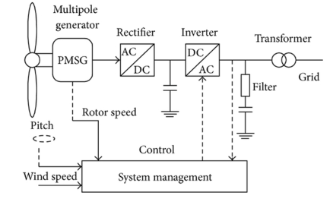
DFIG VS PMSG
DFIG
DFIGs have a wound rotor with a set of slip rings and brushes, allowing for variable rotor currents.
-Enhanced control over the generator's reactive power
-Higher tolerance to grid voltage variations.
-Increased maintenance
PMSG
PMSGs have permanent magnets embedded in the rotor, eliminating the need for a separate excitation system.
-Higher efficiency
-Reduced maintenance requirements
Limited flexibility in controlling the generator's reactive power.

Slide 9
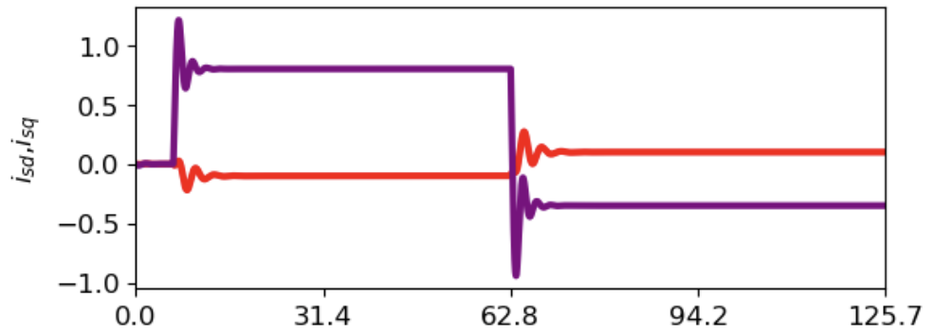
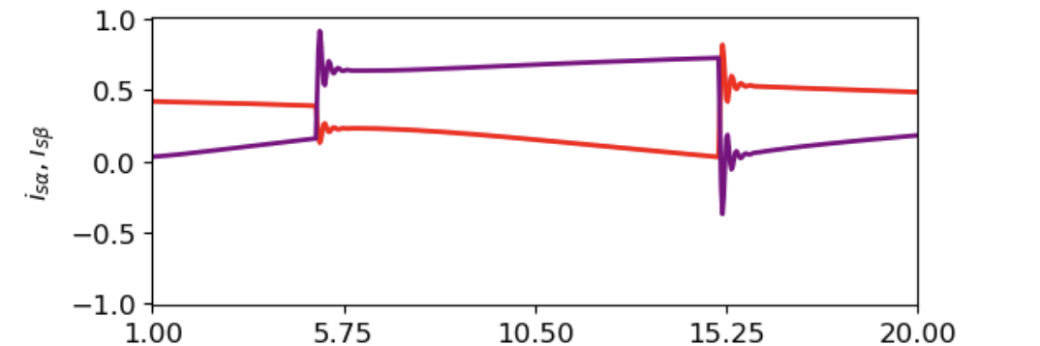
Results: PMSG VS DFIG vector control
PMSG
DFIG
Notes:
Body slide from the first section of the presentation’s middle. Consider having the first-topic image from the mapping slide repeated here. Use the headline (no more than two lines) to make an assertion about this topic. In the body of the slide, support that headline with images and with words, if necessary. See Chapter 4 of The Craft of Scientific Presentations, 2nd ed.
This slide shows one orientation for the image and text in the body of the slide. Other orientations appear in this template. Choose the one that best supports your headline assertion.
Some institutions will insist that you place an institutional logo on each slide. Other institutions recommend a logo on the first slide and the last. If you do place a logo on each slide, make sure that logo is at the bottom of the slide rather than the top. Placing the logo at the top (the place on a slide that receives the most emphasis) shifts the emphasis away from the work.

Slide 10
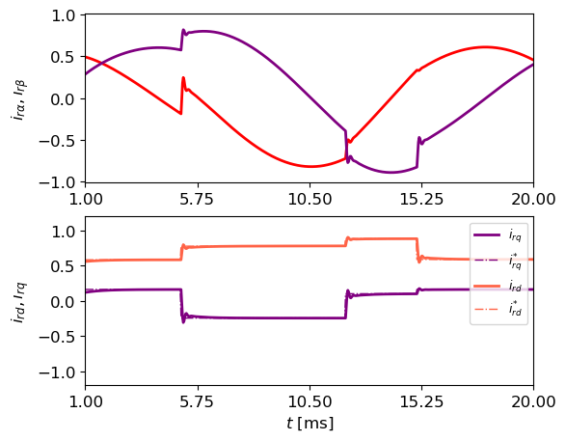
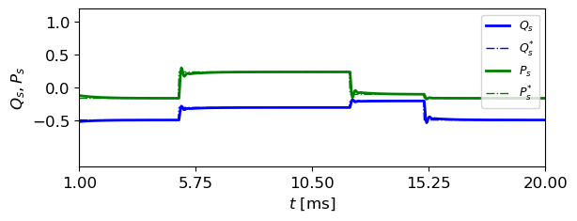
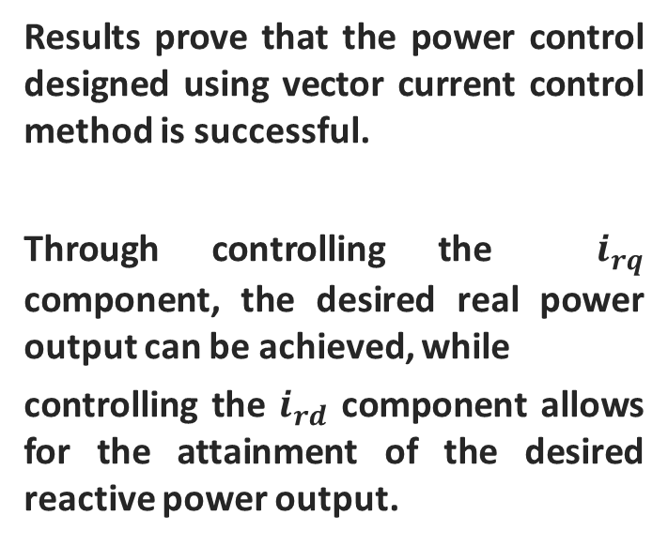
Results：DFIG power control
Results prove that the power control designed using vector current control method is successful.
Through controlling the $i_{rq}$ component, the desired real power output can be achieved, while
controlling the $i_{rd}$ component allows for the attainment of the desired reactive power output.
Notes:
Body slide from the first section of the presentation’s middle. Consider having the first-topic image from the mapping slide repeated here. Use the headline (no more than two lines) to make an assertion about this topic. In the body of the slide, support that headline with images and with words, if necessary. See Chapter 4 of The Craft of Scientific Presentations, 2nd ed.
This slide shows one orientation for the image and text in the body of the slide. Other orientations appear in this template. Choose the one that best supports your headline assertion.
Some institutions will insist that you place an institutional logo on each slide. Other institutions recommend a logo on the first slide and the last. If you do place a logo on each slide, make sure that logo is at the bottom of the slide rather than the top. Placing the logo at the top (the place on a slide that receives the most emphasis) shifts the emphasis away from the work.

